Slide 1

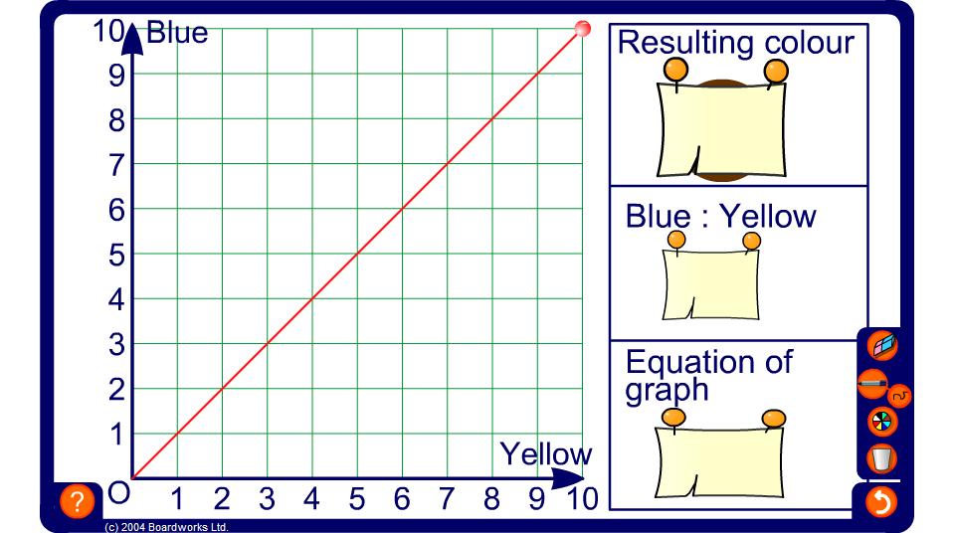


Mixing colours
Notes:
Start by demonstrating how to produce various shades of colour by varying the gradient of the line.
Ask pupils,
If this line is steeper, will the resulting colour be darker or lighter?
Move the end point of the line to the point (5, 10). Ask pupils to justify why a darker colour is produced by interpreting the graph as showing that for 5 parts yellow there are 10 parts blue. For this shade, the ratio of blue to yellow is 10:5 which simplifies to 2:1. The equation of the graph is y = 2x.
Ask pupils to tell you the proportion of yellow paint required to make this shade of paint (1/3).
Ask pupils to tell you how much blue paint and how much yellow paint would be required to make 45 litres of this shade of paint.
Repeat for different shades.
Hide the ratios and the equation of the line and ask pupils to work these out.
Conclude by stressing that when two quantities are directly proportional we can plot points of proportional pairs to produce a straight line passing through the origin. The ratio of the proportional pairs will be constant.

